Slide 1
Mini Project-5 Sem
Face Recognition Attendance System

Slide 2
Project by: Roll no:
Omkar Rasal 2215023
Rajdeep Asane 2215029
Prathamesh Pawar 2215059
Harshal Chaudhari D2225002

Slide 3
INDEX
PROBLEM STATEMENT
INTRODUCTION
SIGNIFICANCE
BASIC STRUCTURE
CONCLUSION

Slide 4
Problem Statement
Face recognition-based attendance system is a problem of recognizing face for taking attendance by using face recognition technology based on high definition monitor video and other information technology. facial image for easier recognition

Slide 5


INTRODUCTION
Traditionally attendance is marked manually by teachers and they must make sure correct attendance is marked for respective student.
This whole process wastes some of lecture time and part of correct information is missed due to fraudulent and proxy cases.

Slide 6
INTRODUCTION
In order to determine classroom attendance, face detection and face recognition are performed. Face detection is used to determine the location of the faces in the classroom image and extract sub images for each face. Then, in face recognition, the face images detected will be compared with the data base consisting of images of students in the class, and attendance will be recorded accordingly.

Slide 7
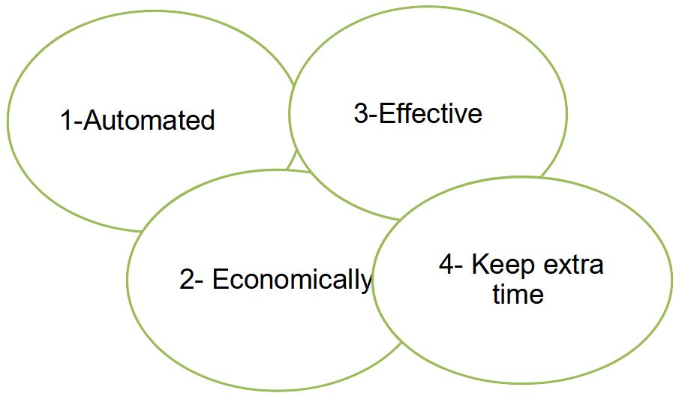
Significance

Slide 8
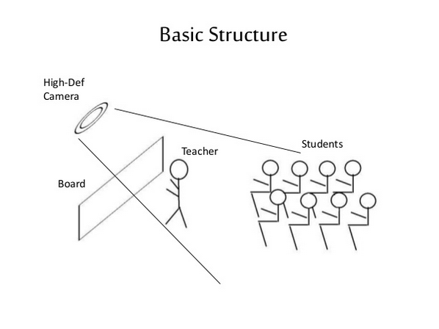

Slide 9
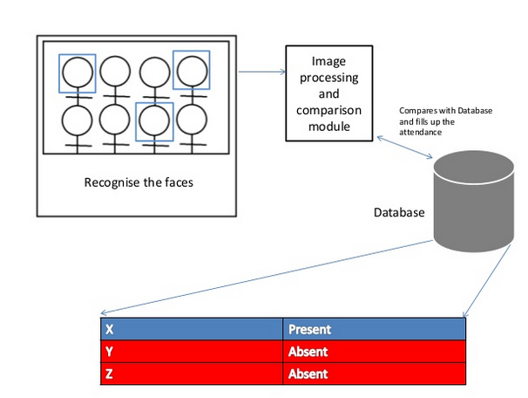

Slide 10
FACE DETECTION
Face detection is a computer technology used to identify human faces in digital images by determining the location of the faces in the image and extract sub images for each face.

Slide 11
Conclusion
advances in digital technology, the quality of facial verification in face recognition attendance systems has improved, and the acceptance rate is relatively high
Face recognition attendance systems’ appeal is enhanced further by their fast image processing time and ease of integration

Slide 12
THANK YOU

